Slide 2
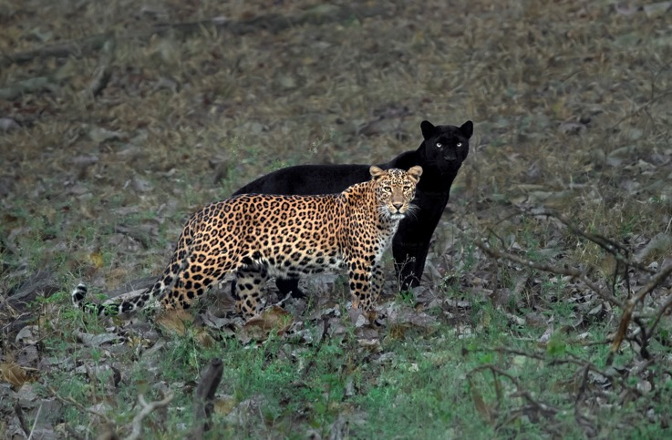
Qualitative vs. quantitative traits
Qualitative trait
Individuals can be assigned to discrete categories
Controlled by single, Mendelian gene
Quantitative trait
Individuals with continuous variation in particular trait (needs to be measured for description)
Controlled by multiple genes and environment

Slide 3
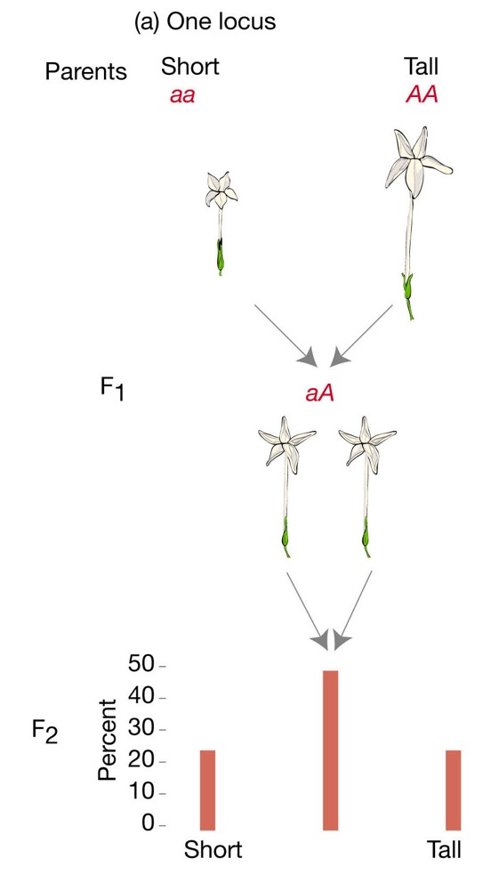
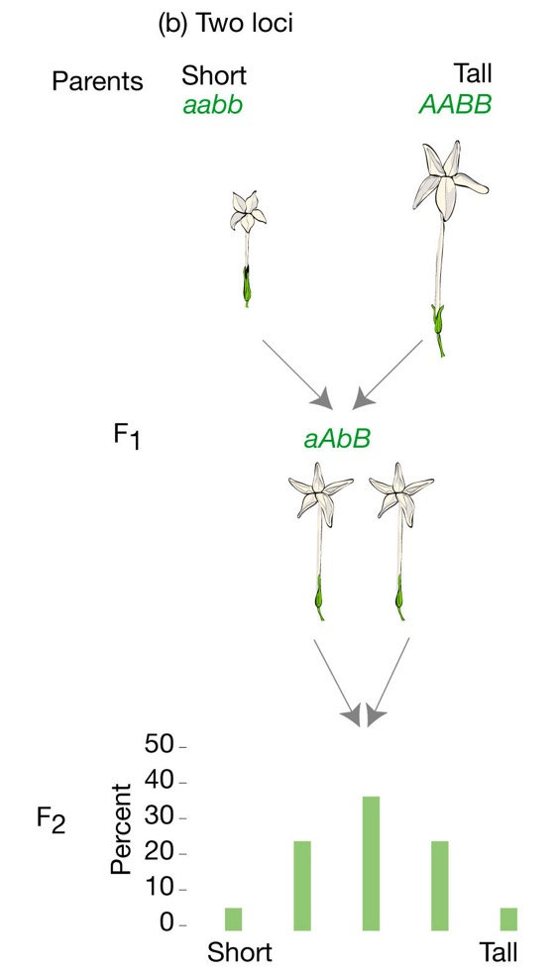
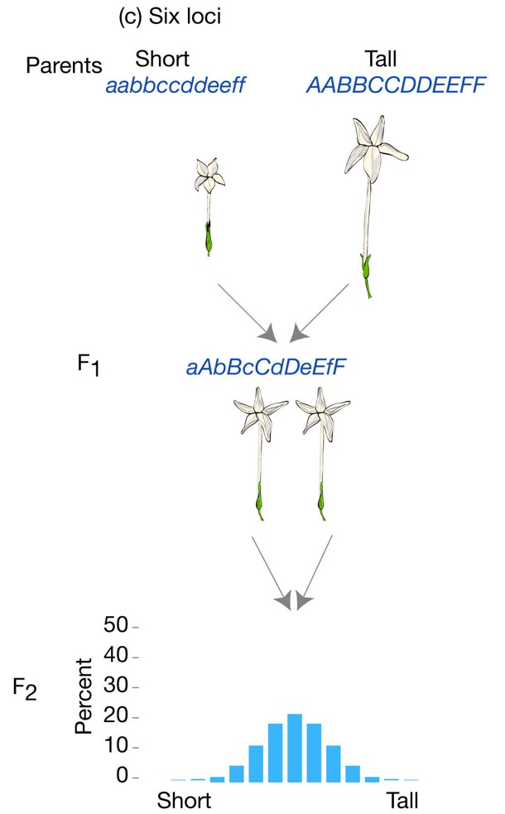
Combined effects of many loci

Slide 4
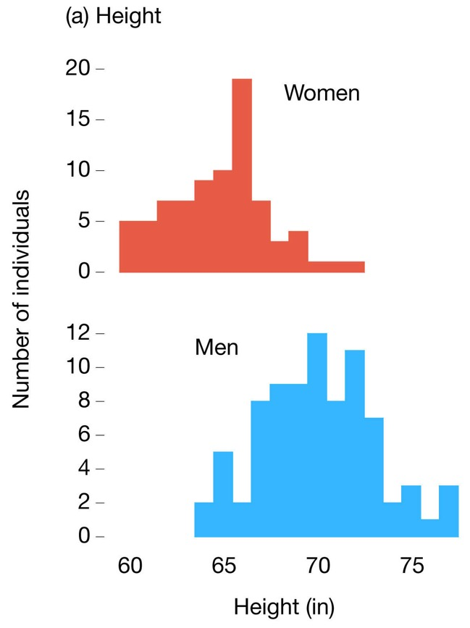
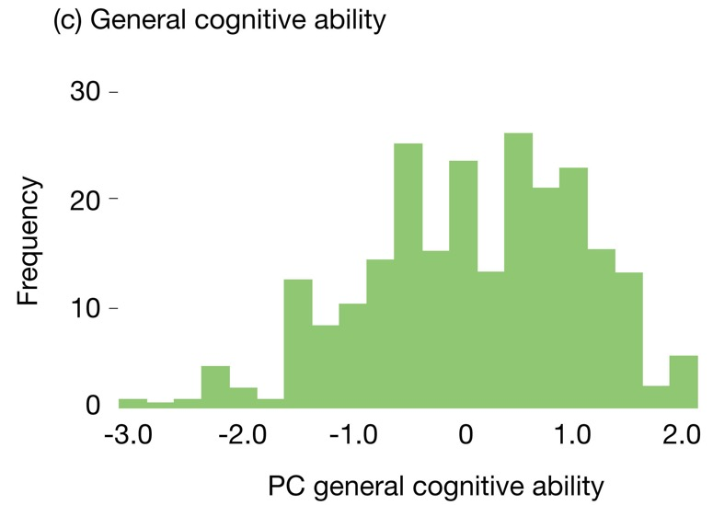
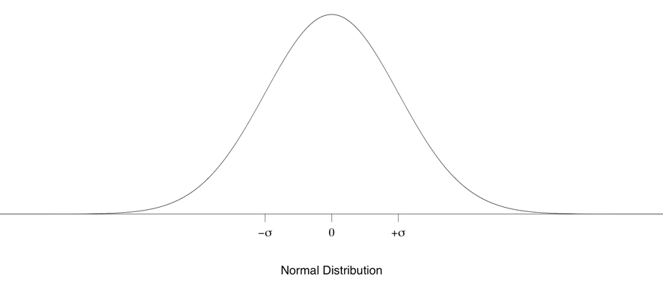
Quantitative traits are normally distributed
Idealized distribution
(when many specimens are measured)

Slide 5
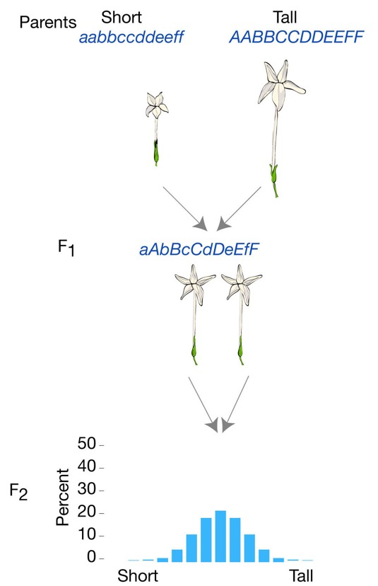
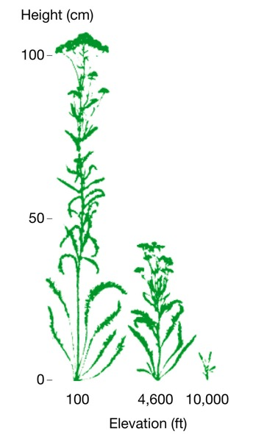
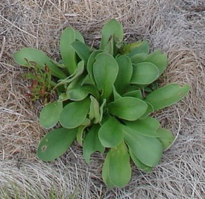
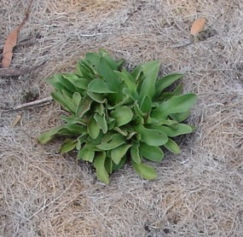
Quantitative traits can be affected by the environment
Environmental variables can modify quantitative traits
The environmentally-dependent expression of different phenotypes by the same genotype is called phenotypic plasticity
Despite continuous variation, plants with the same genotype should have the same phenotype

Slide 6
Analyzing quantitative traits
Quantitative genetics allows for the analysis of evolution by natural selection in traits controlled by many loci
Determine heritability
Determine the strength of selection
Predict evolutionary responses

Slide 7
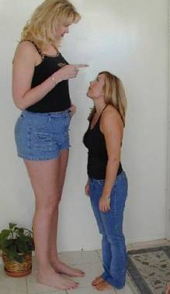

Measuring heritable variation
Nature vs. nurture: Is human height heritable?
Are short individuals short, because they have different genes, because they grew up in different environments, or both?
To disentangle the effects of genes and the environment, a population-level approach is required!

Slide 8
Partitioning phenotypic variation
What proportion of the variation in height among people is due to variation in their genes, and what proportion is due to variation in their environments?
Broad sense heritability:
V_{G}
V_{G}
Heritability =
=
V_{P}
V_{G} + V_{E}

Slide 9
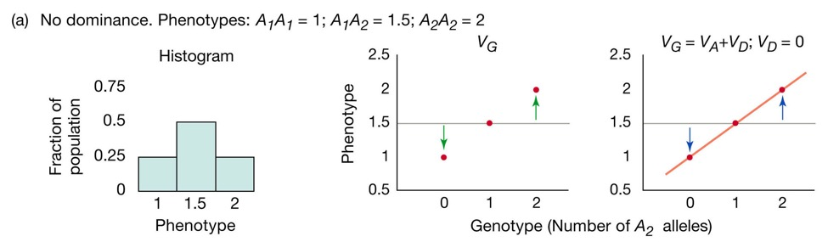
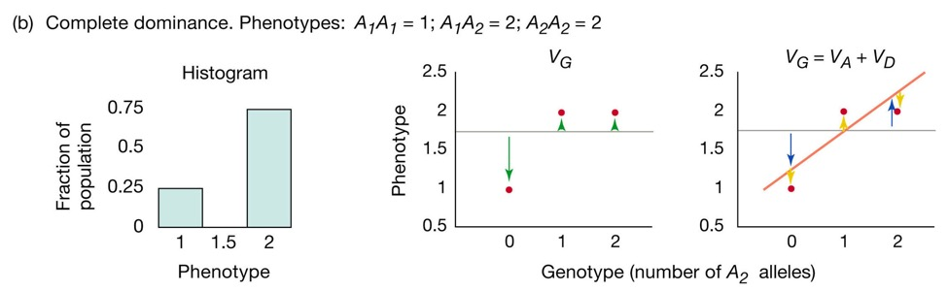
Narrow sense heritability
What proportion of the variation in height among people is due to variation in their genes, and what proportion is due to variation in their environments?
Narrow sense heritability:
V_{G}
=
V_{A} + V_{D}
V_{A}
V_{A}
h² =
=
V_{P}
V_{A} + V_{D}+ V_{E}
Narrow sense heritability focuses on the effects of additive genetic variation
Dominance genetic variation is excluded
Only additive genetic variation allows for prediction of a population’s response to selection

Slide 10
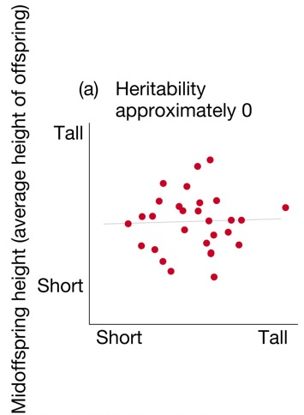
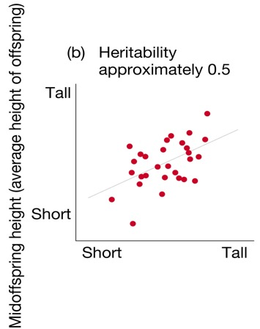
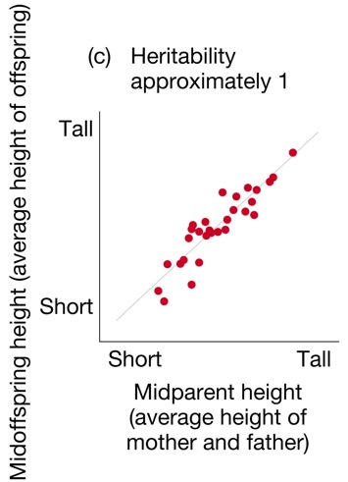
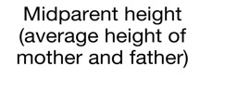
Narrow sense heritability
Narrow sense heritability can be estimated as the slope of the regression line between parent and offspring traits
If 1, all variation is due to V_{A}
If 0, much variation is due to V_{E}

Slide 11
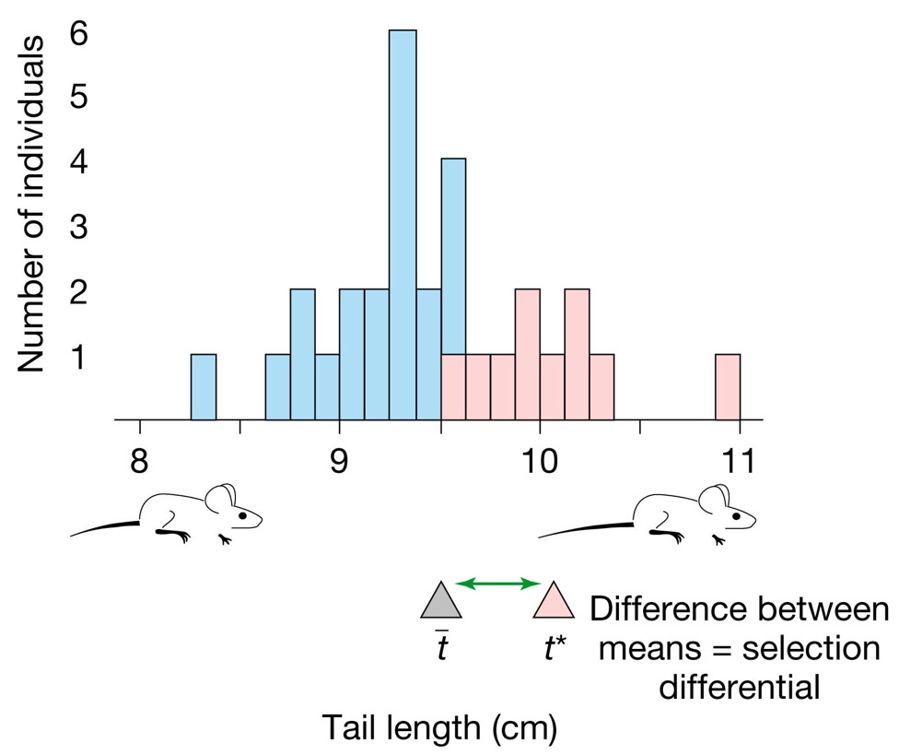
Measuring differences in fitness
The selection differential (s) is equal to the difference between the mean of the selected individuals and the mean of the entire population

Slide 12
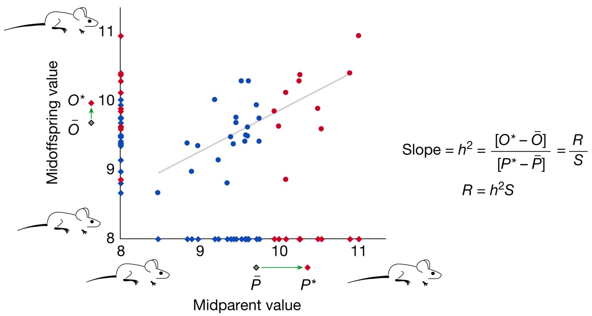
Predicting the response to selection
Breeder’s equation
R = h² * S
How does response to selection (R) vary with h²?
How does response to selection (R) vary with S?

